Slide 1
Lesson 4 Chapters 7-8
Tic-Tac-Toe Applet
Errors and Exceptions
UML

Slide 2
HTML-elements
An element starts with ‘<‘ and ends with ‘>’.
A start element ‘<tag>’ must always be followed somewhere with an end element ‘</tag>’.
In between there can be other tags nested.
An element with nothing inside is called an empty element ‘<tag />’.

Slide 3
HTML-attributes
Each element can have attributes.
An attribute has a name, and a value separates by an equals sign.
The value must be in double-quotes.
Example:
<td colspan="5">

Slide 4
HTML-document
An HTML documents outer element must be named ‘html’.
Inside it will have a ‘header’ element followed by a ‘body’ element.
The ‘header’ and ‘body’ element also has nested elements inside them.

Slide 5
HTML-rendering
HTML files are text files, but is rendered in Web Browsers graphically.
The Web Browser interprets the elements and attributes in the HTML file.

Slide 6
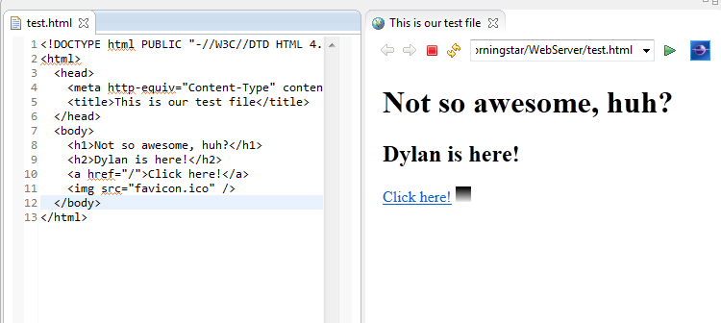
HTML-example

Slide 7
Tic-Tac-Toe Applet
A special HTML element is called ‘applet’.
It can be used to run Java code inside a Web Browser.

Slide 8
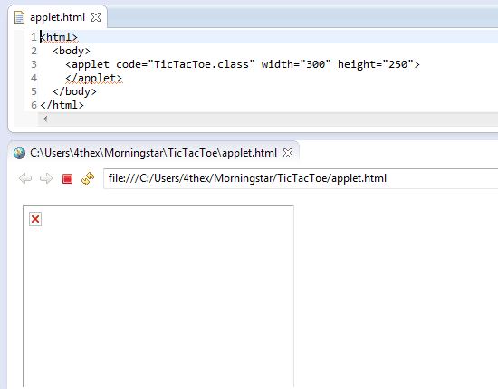
Tic-Tac-Toe Applet
Notes:
The web browser cannot find the class ‘TicTacToe’, so it just shows a blank rectangle with a red ‘x’ in it.

Slide 9
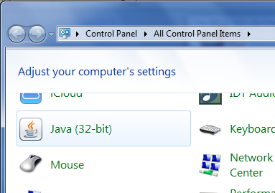
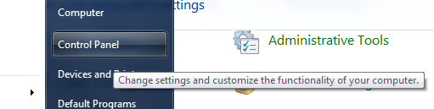
Java Security
Notes:
Open Control Panel and click ‘Java’

Slide 10
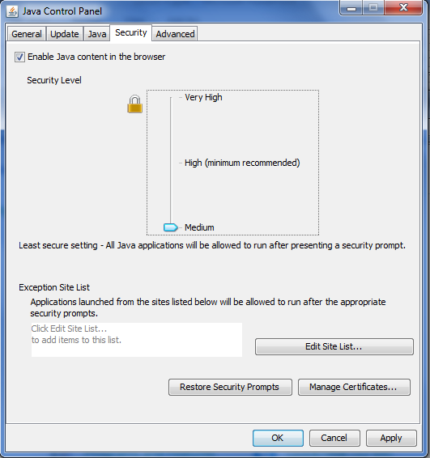
Java Security
Notes:
Slide the ‘Security Level’ down to ‘Medium’
Click ‘Apply’

Slide 11
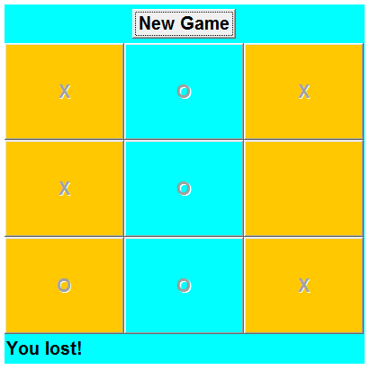
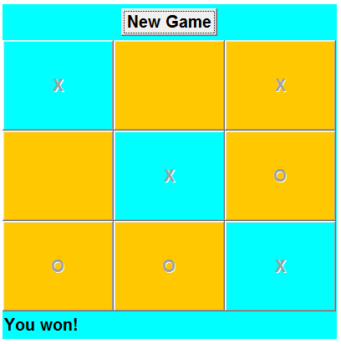
Tic-Tac-Toe Applet
Notes:
Open the ‘applet.html’ file in a browser.
Make sure that the browser process has been completely restarted first.

Slide 12
Handling Errors
Throwing and catching Exceptions

Slide 13
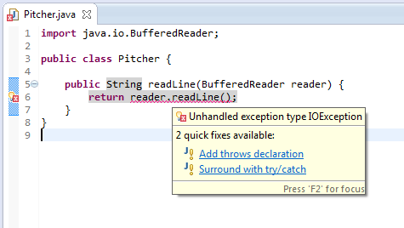
Try - Catch
Notes:
If you add a method call in your code to a method that throws an exception, the compiler will complain saying that there in an unhandled exception.
You can then decide to declare that your method throws the exception, or try to catch it.

Slide 14
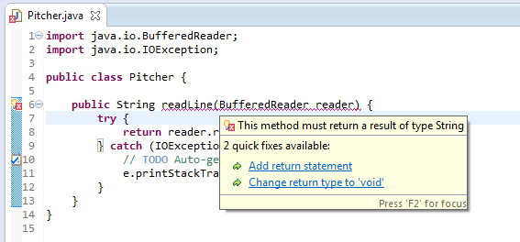
Try - Catch
Notes:
I chose to catch the exception, but the compiler is still not happy.
Now because I caught the exception, the method is no longer guaranteed to return a value.

Slide 15
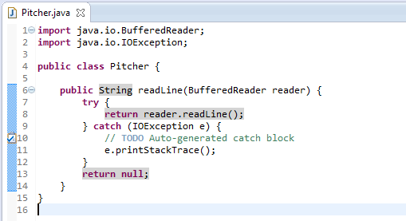
Try - Catch
Notes:
Now if there was an exception thrown, we will return null.
Notice the printStackTrace method. It will print out a stack of the previous method calls, so you can track where the error occurred.

Slide 16
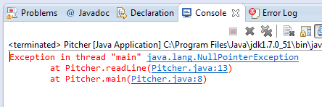
Stack Trace
Notes:
Read from the bottom. Click on any of the links to go to the line.
Notice that the NullPointerException is not an IOException.

Slide 17
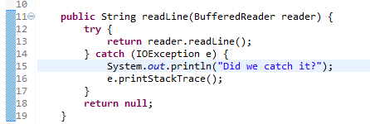
Stack Trace
Notes:
We can see that if we add the following line to our code, we don’t see that in the output. So we didn’t actually catch the exception.
That is because NullPointerException is not an IOException.

Slide 18
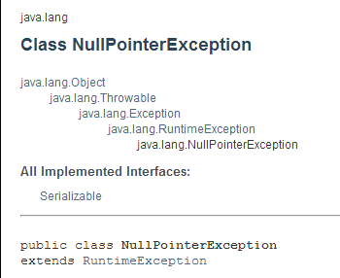
Runtime Exception
Notes:
This exception is a RuntimeException, and these do not need to be declared.
It still extends from Throwable, which means that we can catch it. Let’s “try”.

Slide 19
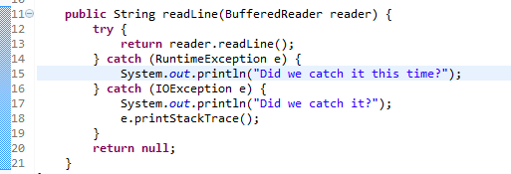
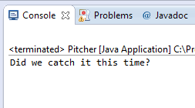
RuntimeException
Notes:
When an exception is thrown, the JVM goes through the catch clauses in order, so if one exception extends from another, that has to come first, otherwise the more general exception clause is always caught. Let’s try it.

Slide 20
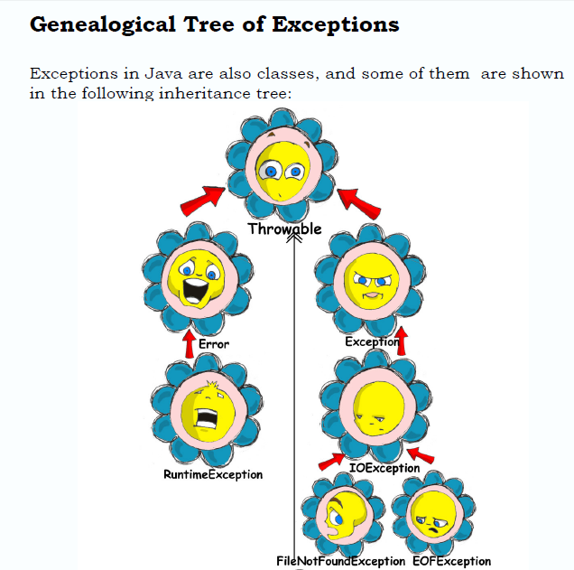
Book Errata
Chapter 8, page 114 (126 in the file)

Slide 21
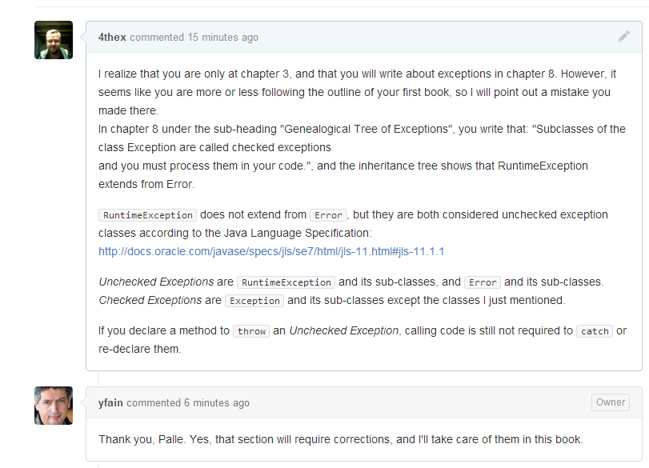
Book Errata
https://github.com/yfain/Java4Kids_NoStarchPress/issues/1

Slide 22
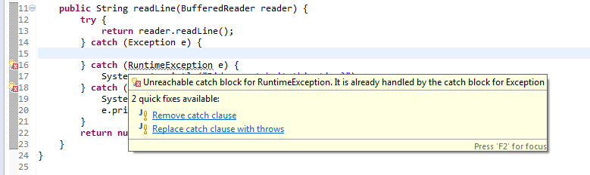
Catch order
Notes:
The compiler complains that we tried to catch the more general Exception first.

Slide 23
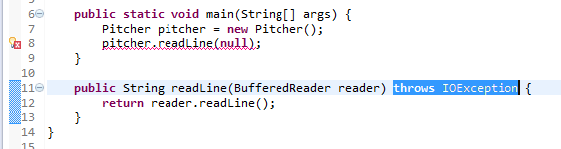
Throws
Notes:
We can choose to declare that our method throws IOException. In that case the problem is moved to the code that calls the method. We can see that now the compiler complains that the main method should catch the exception.

Slide 24
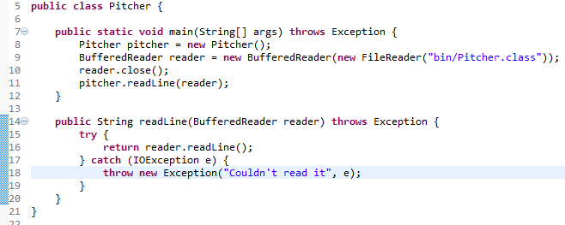
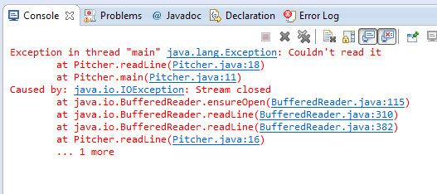
Throw
Notes:
Notice how we now throw a new exception in the catch clause.
We now see in the stack trace that there is a “Caused by:” statement. So we can see that we can add some more information to the stack trace that way.
That is the recommended practice if you declare throws, that you also catch the exception that caused it, and then re-throw it.

Slide 25
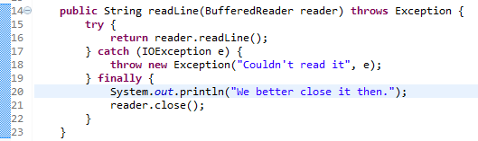
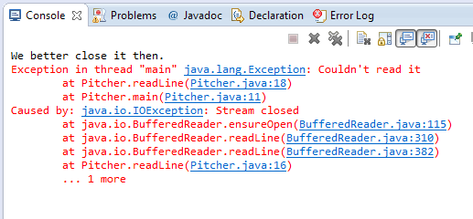
Finally
Notes:
Finally, you might want to always do something whether or not an exception was thrown. You put that in the finally clause. Beware that what you do here can also thrown an exception, maybe.
Notice how we got the finally clause executed.

Slide 26
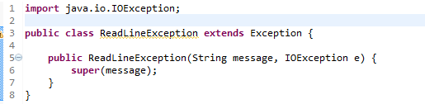
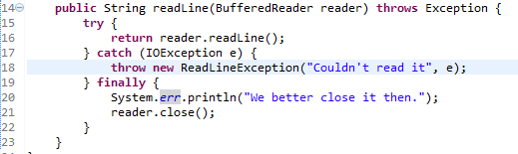
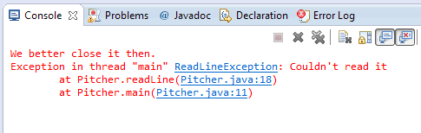
Create your own
Notes:
We created a new class ReadLineException that extends Exception.
We see in the stack trace that we get our own exception.

Slide 27
UML
Class Diagram

Slide 28
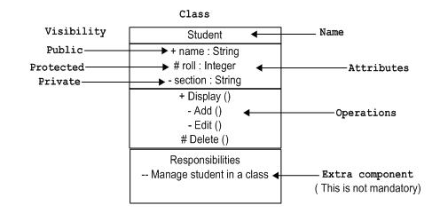
Class

Slide 29
Generalization – extends
Person
# name: String
A student has a name because
a student is a person
Student
- courses: Course[0..n]
A student attends a number of courses
Not every person does that
A student is a specific kind of person

Slide 30
Realization - Implements
<<Interface>>
Learner
<<Interface>>
Runner
+ learn(material: Material)
+ run(distance: Distance)
The line is dashed indicating
a weaker relationship.
A student is not only a learner
She is just able to learn
Student
One class can implement more than one interface

Slide 31
Association – Uses uni-directional
Course
Student
- students: Student[1..n]
The direction of the arrow indicates
who uses what.

Slide 32
Association - Uses bi-directional
If both classes uses each other
there is no arrow.
Teacher
1..n
1..200
Student
- students: Student[0..n]
- teachers: Teacher
1..10
Course
Cardinality

Slide 33
Association - Knows uni-directional
The book doesn’t know about
the student
Student
Book
- books: Book[0..n]
The line is dashed indicating a
weaker relationship

Slide 34
Association - Aggregation
Here uni-directional because the pages don’t know about the book.
Book
1..1000
Page
# pages: Page[1..1000]
The pages are part of the book
You would say that a book aggregates
pages.

